Slide 1
Unlocking Financial Wisdom: Building Knowledge Graphs from Investopedia
-by Isha Patro

Slide 2

Here on my first day, I have already mastered the art of nodding at terms I don’t understand
Here on my first day, already mastered the art of nodding at terms I don’t understand

Slide 3

Purpose
Transform the way financial information is accessed and understood, promoting greater financial literacy by using Knowledge Graphs

Slide 4
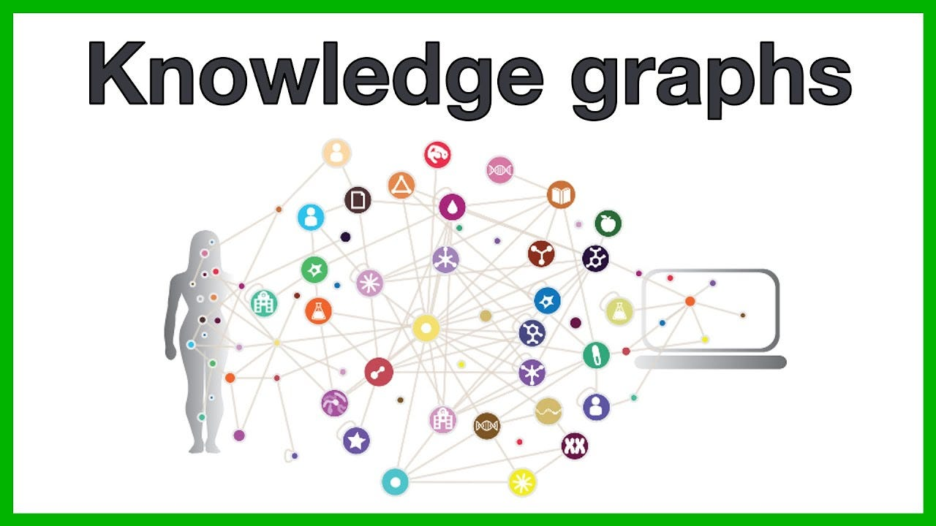
What are Knowledge Graphs?
Knowledge graphs are a way to store and organize information in a graph format, where entities (nodes) represent objects, concepts, or events, and the connections (edges) between them represent the relationships between these entities.

Slide 5
Scrape Investopedia Data
Select Topic of Interest
Filter data by Topic
Integrate into Obsidian Vault
Construct Knowledge Graph
Discover Relationships with LLM Models

Slide 6
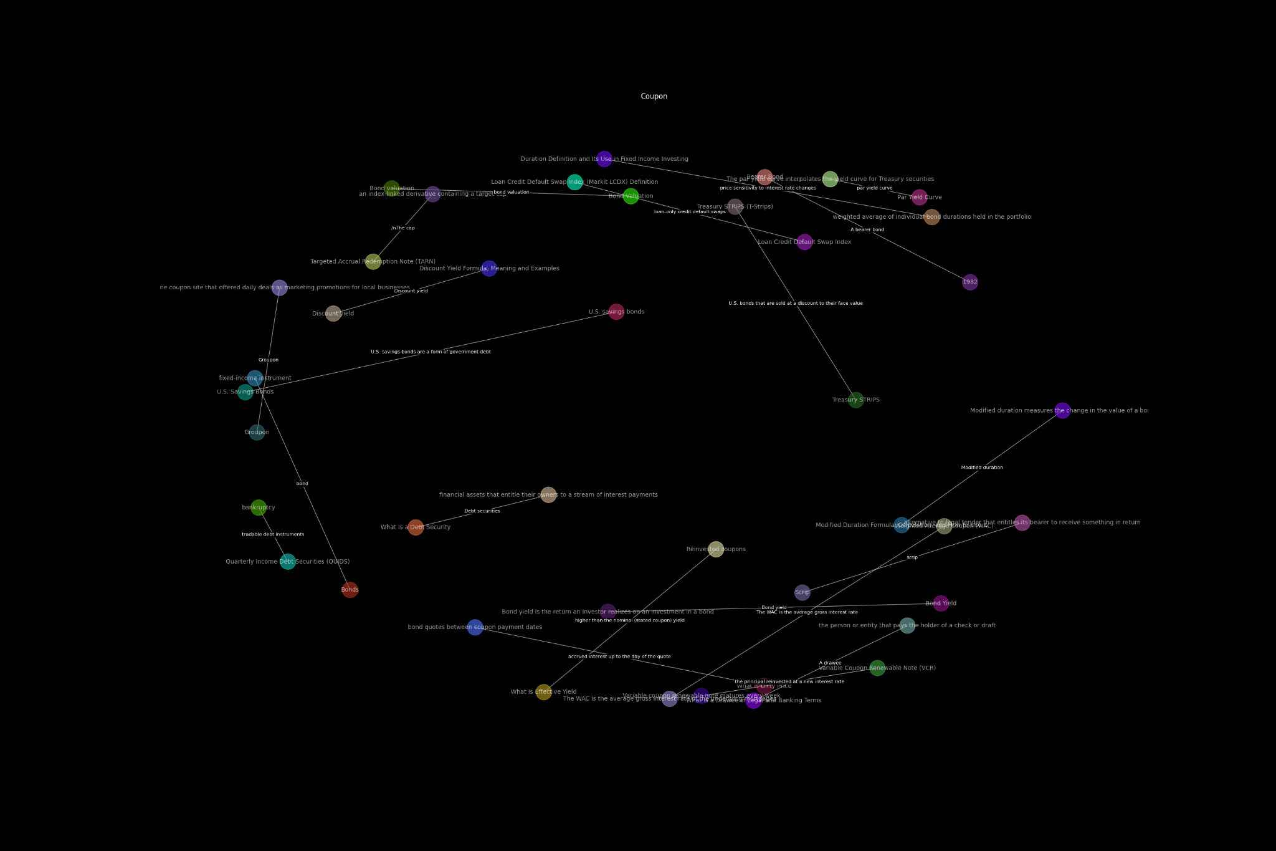

Slide 7
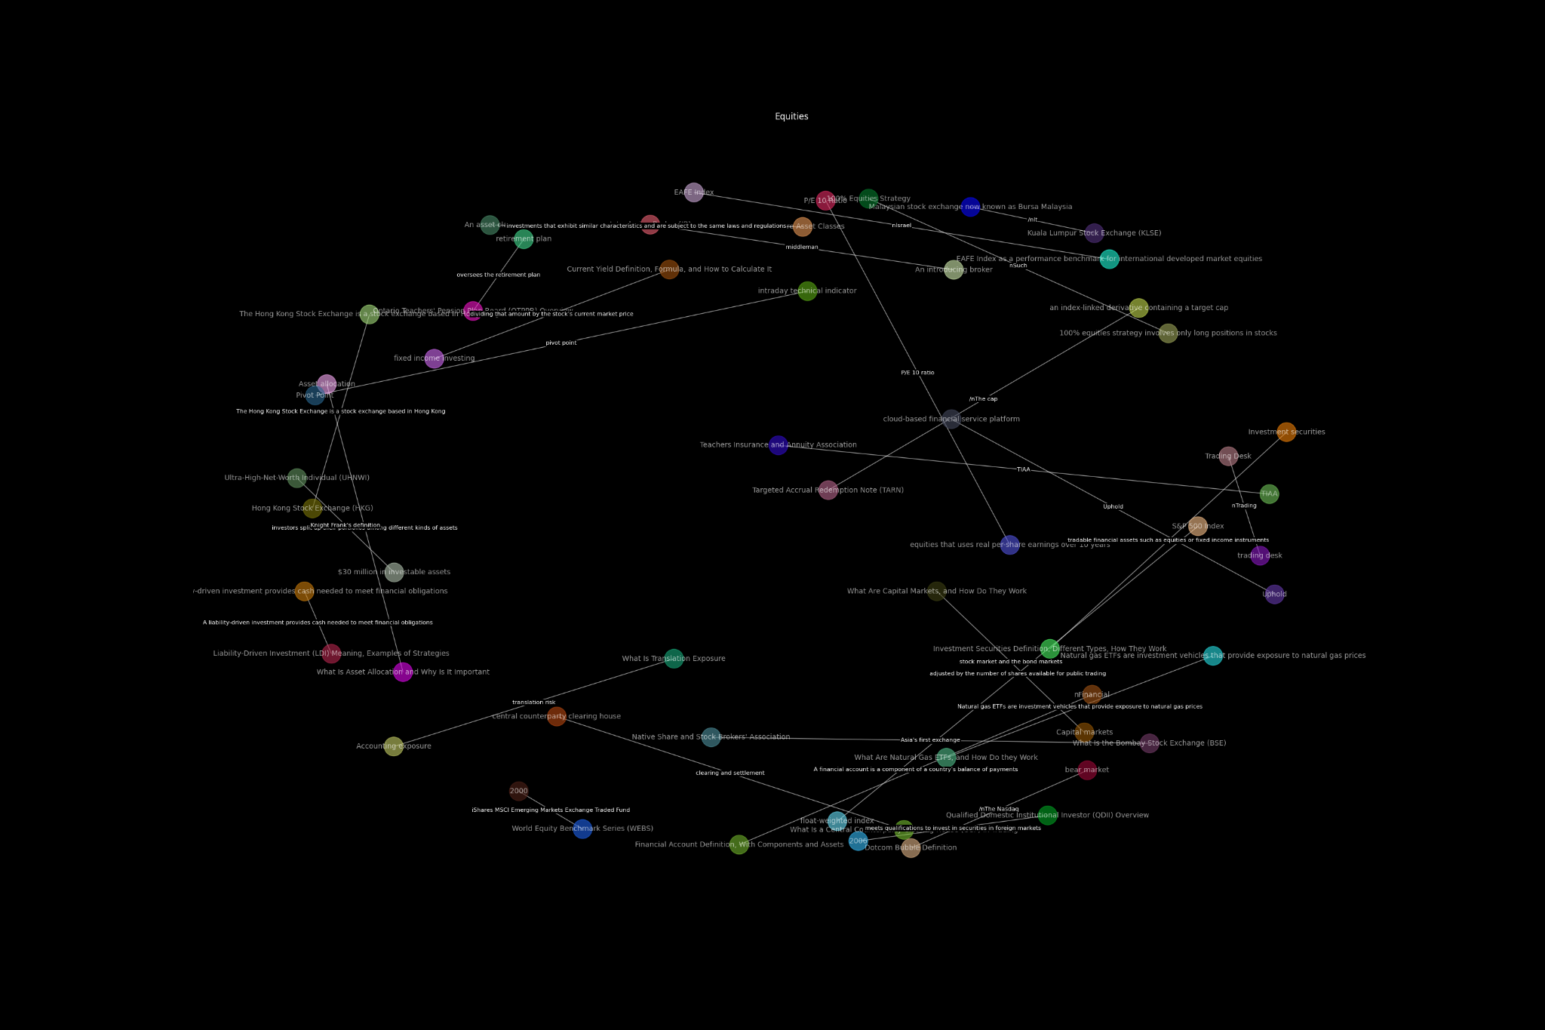

Slide 8


Slide 9
Slide 3: Methods Overview
Visual: Flowchart or infographic detailing the steps from data collection to knowledge graph construction.
Content:
Data Collection: Using Python and BeautifulSoup
Data Processing with Pandas
AI Techniques for Graph Construction
Slide 4: Knowledge Graph Visualization
Visual: A screenshot or dynamic visual of the knowledge graph in NetworkX and Obsidian.
Content: Caption explaining the tools used and the integration process for interactive exploration.
Slide 5: Key Insights through Visuals
Visual: Separate visuals for key segments like Bond Markets, Equity Investments, etc.
Content: Short captions summarizing insights from each visualized segment.
Slide 6: Real-World Applications
Visual: Case study snapshots showing the graph in use during strategy sessions and educational settings.
Content: Brief descriptions of how the knowledge graph was applied in real scenarios.
Slide 7: Challenges and Solutions
Visual: Diagram showing problems faced and the solutions applied, perhaps with icons or simple animations.
Content: Minimal text highlighting major challenges like accuracy and computational demands, with succinct notes on the solutions.
Slide 8: Future Directions and Conclusion
Visual: A roadmap graphic or future vision collage showing potential improvements and expansions.
Content:
Quick notes on future research directions
A concluding remark on the impact of the knowledge graph

